Slide 1
K-Means Clustering 生醫光電所 吳育德
Chap6. A First Course in Machine Learning, 2ed, Simon Rogers and Mark Girolami, 2017

Slide 2
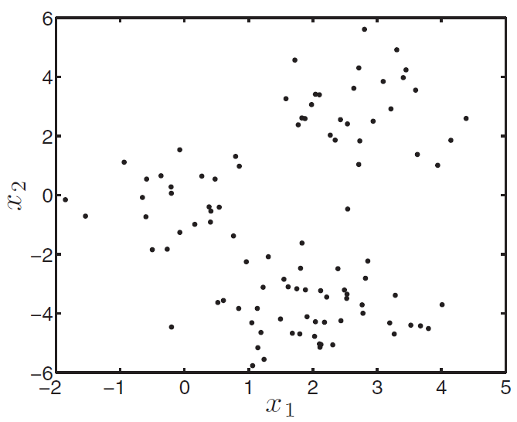
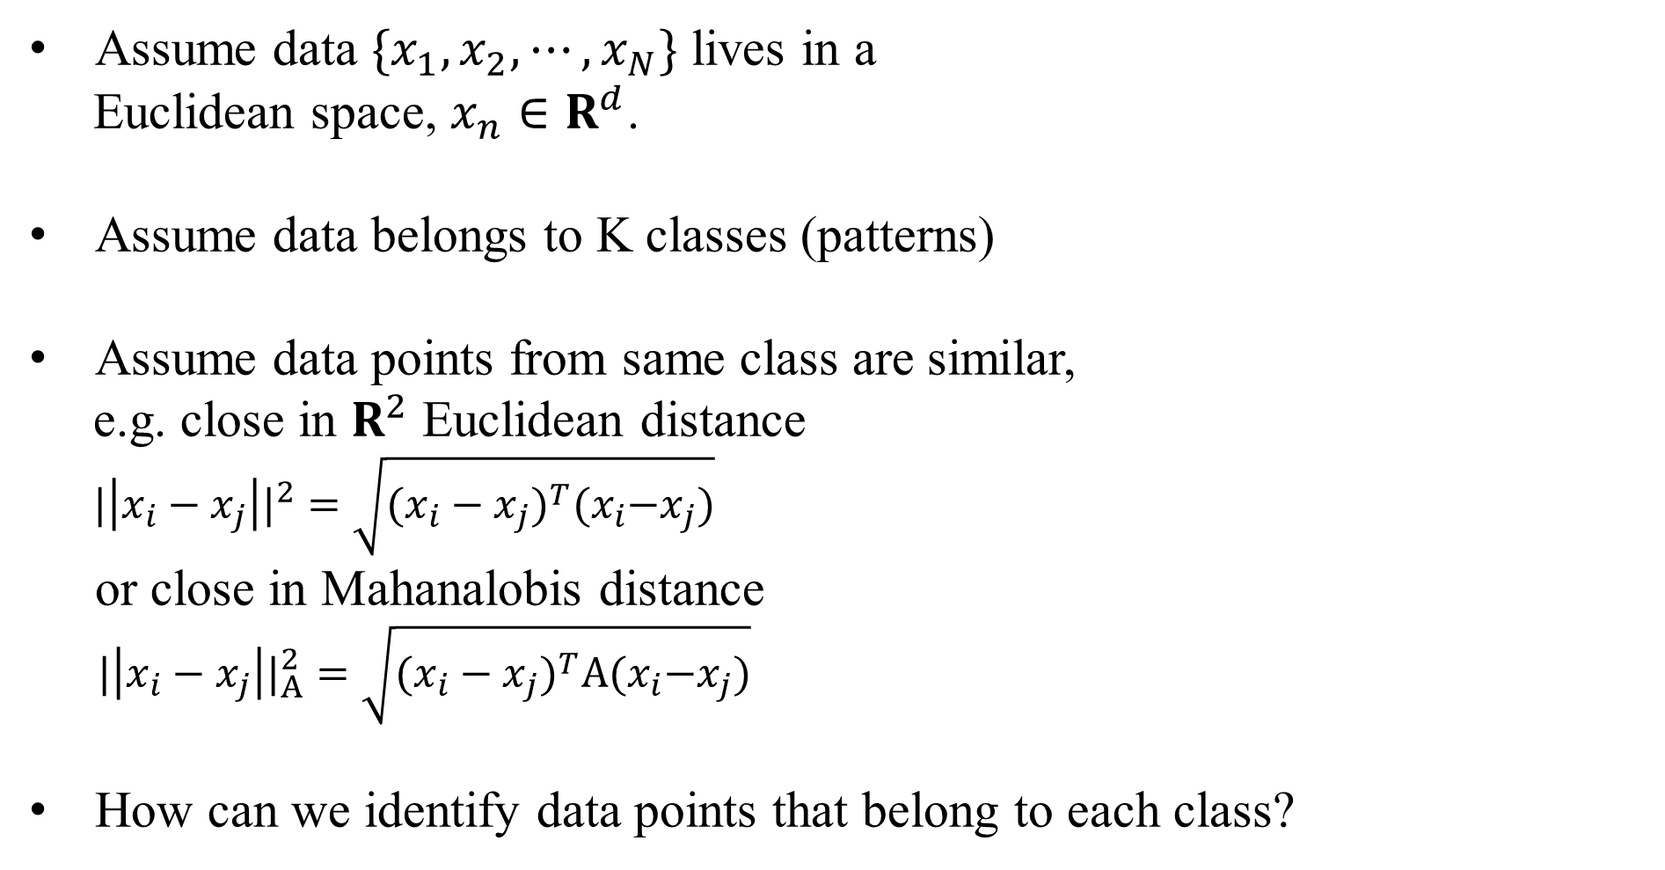
K-Means Clustering
Assume data $\{x_{1}, x_{2}, ⋯,x_{N}\}$ lives in a
Euclidean space, $x_{n}∈R^{d}$.
Assume data belongs to K classes (patterns)
Assume data points from same class are similar,
e.g. close in $R^{2}$ Euclidean distance
${|\left|x_{i}−x_{j}\right||}^{2}=\sqrt{{(x_{i}−x_{j})}^{T}{(x}_{i}−x_{j})}$
or close in Mahanalobis distance
${|\left|x_{i}−x_{j}\right||}_{A}^{2}=\sqrt{{(x_{i}−x_{j})}^{T}A{(x}_{i}−x_{j})}$
How can we identify data points that belong to each class?

Slide 3
K-Means: intuition
K-means assumes there are K clusters, and each point is close to its cluster center (the mean of points in the cluster).
If we knew the cluster assignment we could easily compute means.
If we knew the means we could easily compute cluster assignment.
Chicken and egg problem!
Very simple (and useful) heuristic - start randomly and alternate between the two!

Slide 4
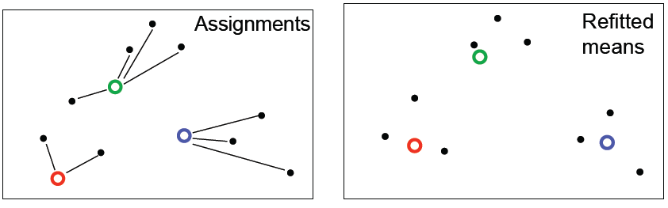
K-Means Clustering
Initialization: randomly initialize cluster centers
The algorithm iteratively alternates between two steps:
Assignment step: Assign each data point to the closest cluster
Refitting step: Move each cluster center to the center of gravity of the data assigned to it

Slide 5
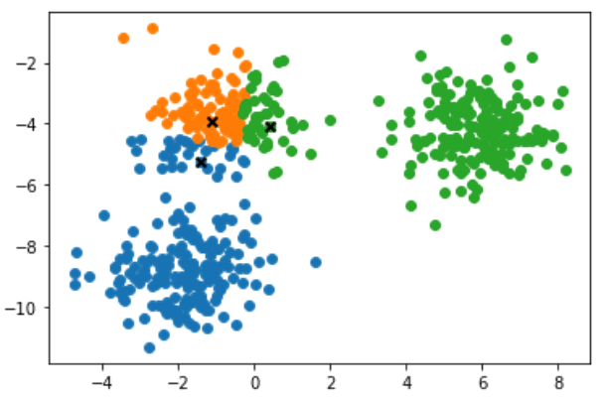
K-Means: example

Slide 6
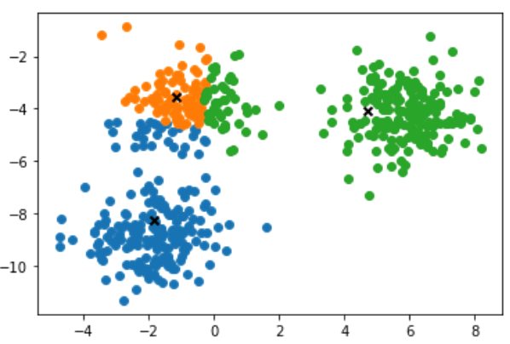
K-Means: example

Slide 7
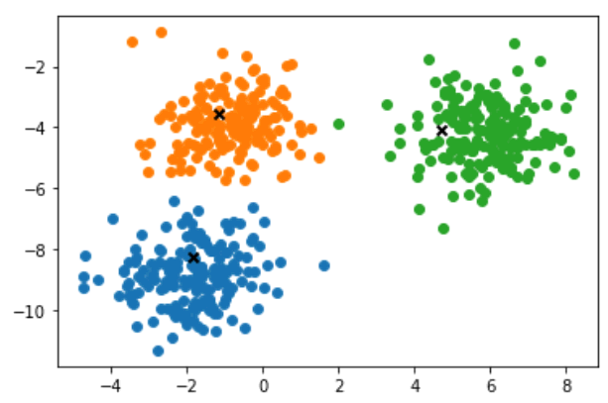
K-Means: example

Slide 8
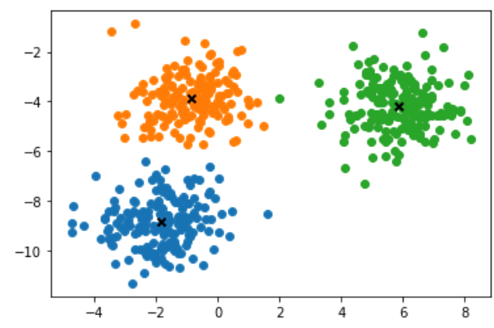
K-Means: example

Slide 9

K-Means: example

Slide 10
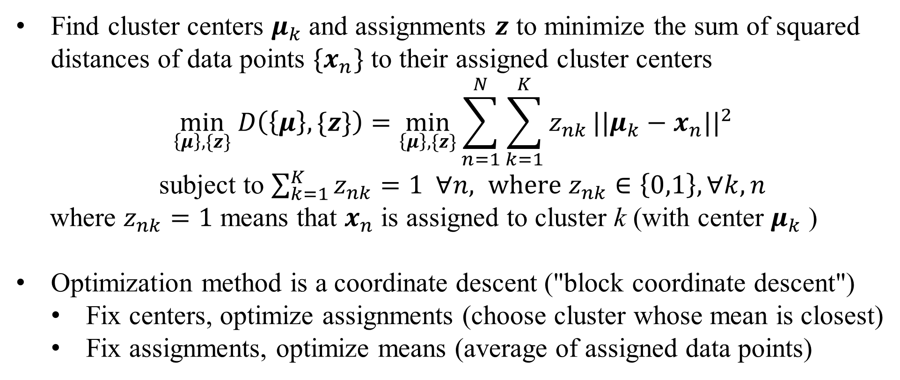
K-Means objective function
Find cluster centers $μ_{k}$ and assignments $z$ to minimize the sum of squared distances of data points ${\{x}_{n}\}$ to their assigned cluster centers
$$\min_{\left\{μ\right\},\{z\}} D\left(\left\{μ\right\},\{z\}\right)=\min_{\left\{μ\right\},\{z\}}\sum_{n=1}^{N}{\sum_{k=1}^{K}{z_{nk}}{||μ_{k}−x_{n}||}^{2}}$$
subject to $\sum_{k=1}^{K}{z_{nk}}=1 ∀n, where z_{nk}∈\left\{0,1\right\}, ∀k,n$
where $z_{nk}=1$ means that $x_{n}$ is assigned to cluster k (with center $μ_{k}$ )
Optimization method is a coordinate descent ("block coordinate descent")
Fix centers, optimize assignments (choose cluster whose mean is closest)
Fix assignments, optimize means (average of assigned data points)

Slide 11
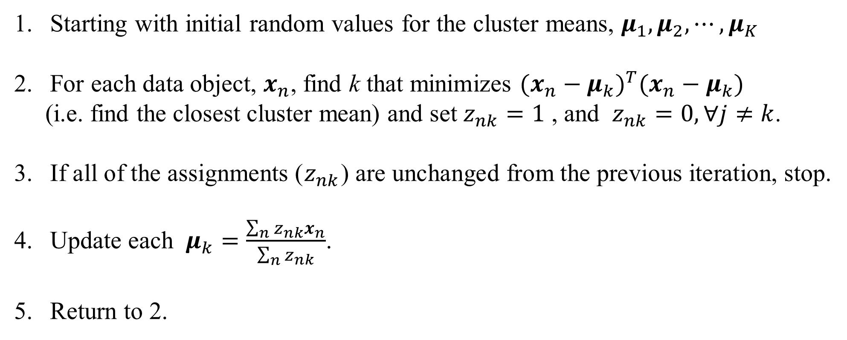
K-Means Algorithm
Starting with initial random values for the cluster means, $μ_{1}, μ_{2}, ⋯,μ_{K}$
For each data object, $x_{n}$, find k that minimizes ${(x_{n}−μ_{k})}^{T}(x_{n}−μ_{k})$
(i.e. find the closest cluster mean) and set $z_{nk}=1$ , and $z_{nk}=0, ∀j≠k$.
If all of the assignments ($z_{nk}$) are unchanged from the previous iteration, stop.
Update each $μ_{k}=\frac{\sum_{n}{z_{nk}x_{n}}}{\sum_{n}{z_{nk}}}$.
Return to 2.

Slide 12
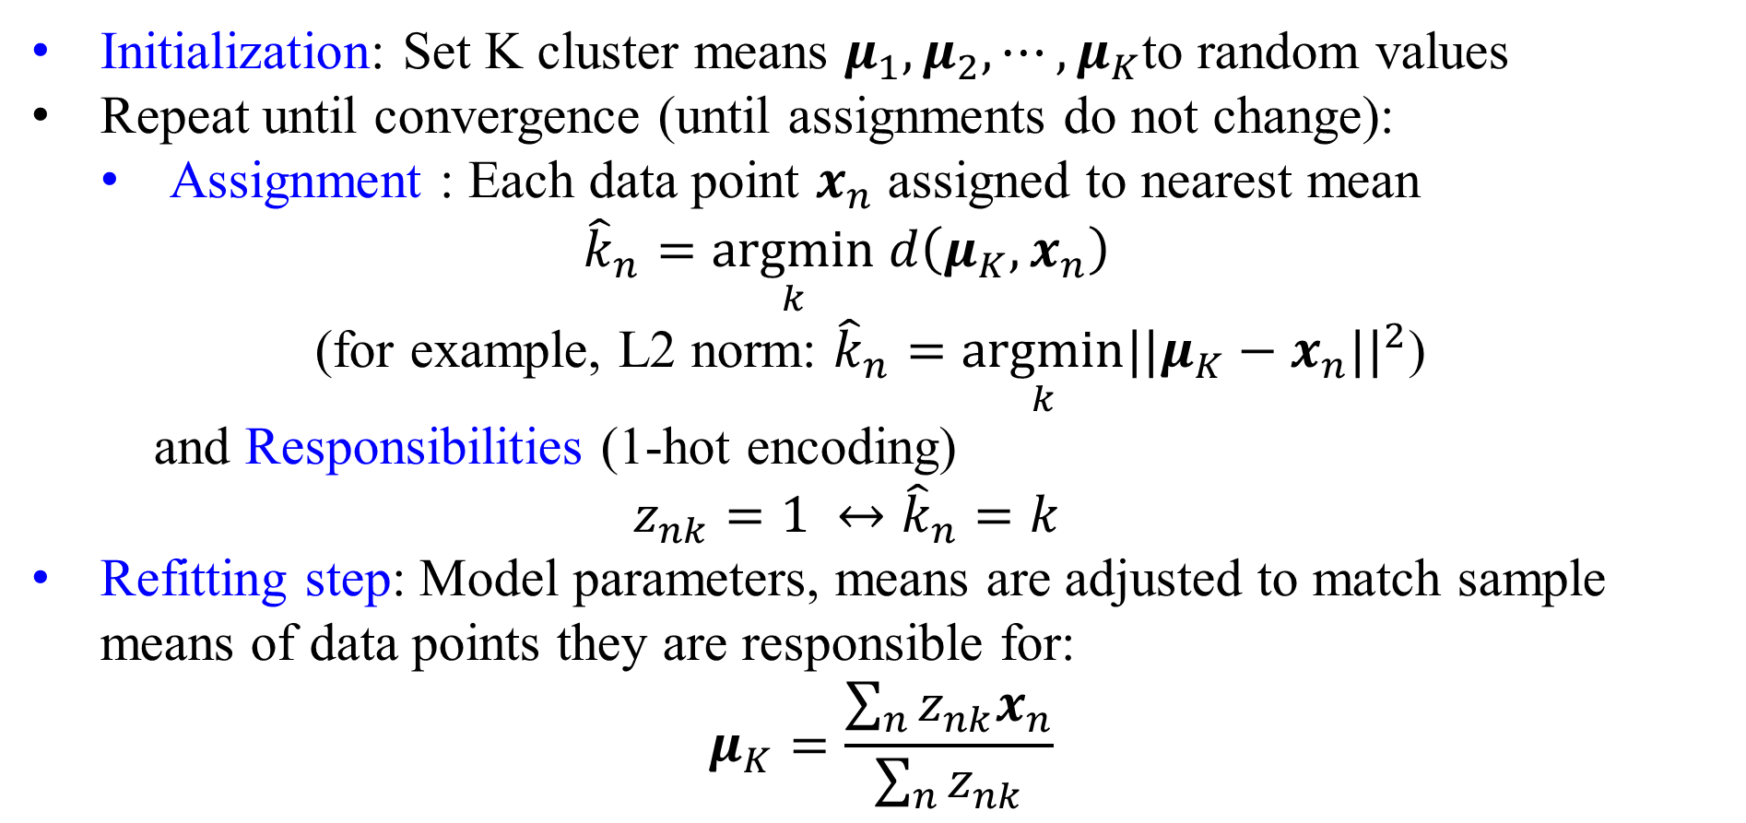
K-Means Algorithm
Initialization: Set K cluster means $μ_{1}, μ_{2}, ⋯,μ_{K}$to random values
Repeat until convergence (until assignments do not change):
Assignment : Each data point $x_{n}$ assigned to nearest mean
$${\hat{k}}_{n}=\underset{k}{argmin} d\left(μ_{K},x_{n}\right)$$
(for example, L2 norm: ${\hat{k}}_{n}=\underset{k}{argmin}{||μ_{K}−x_{n}||}^{2}$)
and Responsibilities (1-hot encoding)
$$z_{nk}=1 ↔{\hat{k}}_{n}=k$$
Refitting step: Model parameters, means are adjusted to match sample means of data points they are responsible for:
$$μ_{K}=\frac{\sum_{n}{z_{nk}x_{n}}}{\sum_{n}{z_{nk}}}$$

Slide 13
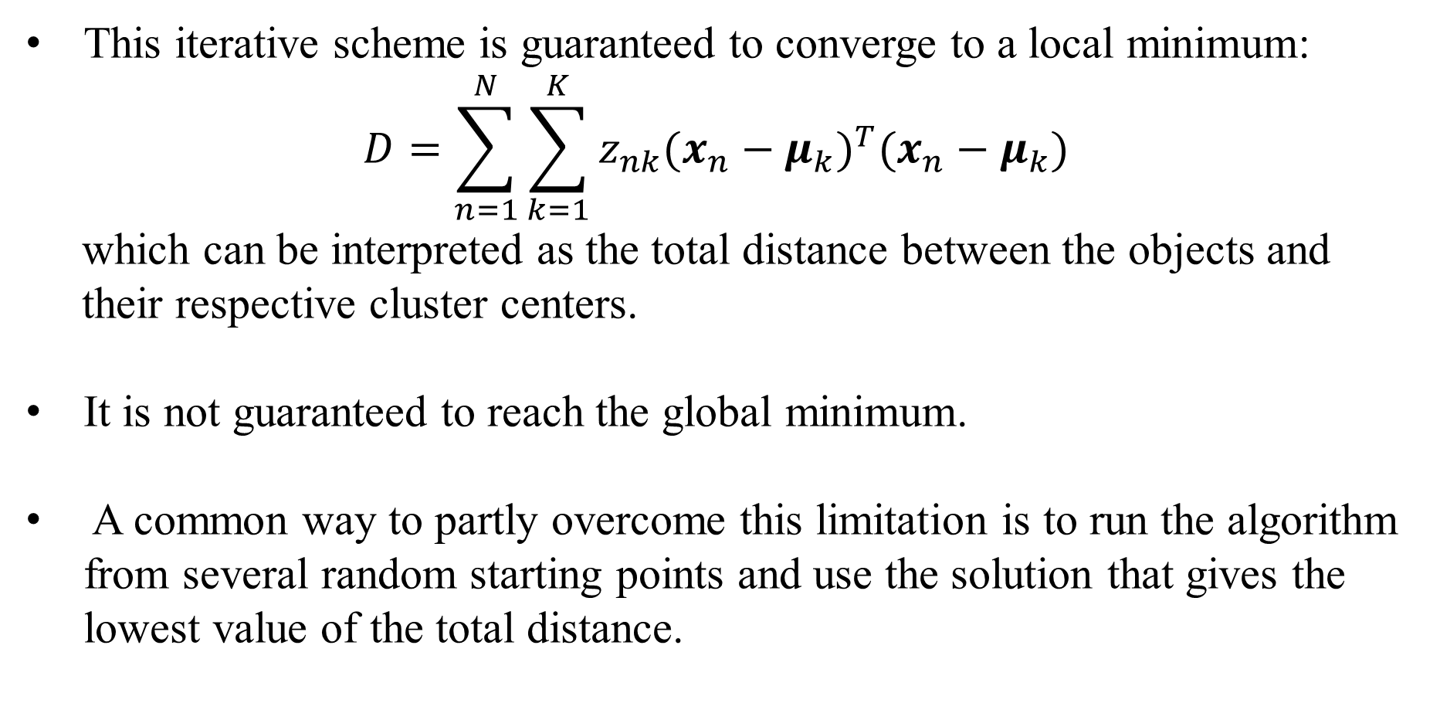
Convergence of K-Means Algorithm
This iterative scheme is guaranteed to converge to a local minimum:
$$D=\sum_{n=1}^{N}{\sum_{k=1}^{K}{z_{nk}{(x_{n}−μ_{k})}^{T}(x_{n}−μ_{k})}}$$
which can be interpreted as the total distance between the objects and
their respective cluster centers.
It is not guaranteed to reach the global minimum.
A common way to partly overcome this limitation is to run the algorithm from several random starting points and use the solution that gives the lowest value of the total distance.

Slide 14
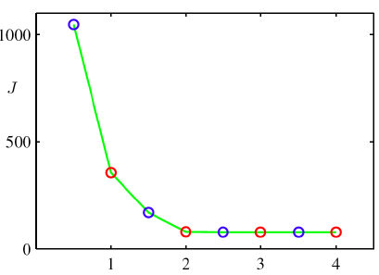
Why K-Means converge ?
Whenever an assignment is changed, the sum squared distances D of data points from their assigned cluster centers is reduced.
Whenever a cluster center is moved, D is reduced.
Test for convergence: If the assignments do not change in the assignment step, we have converged (to at least a local minimum).
K-means cost function after each E step (blue) and M step (red). The algorithm has converged after the third M step

Slide 15
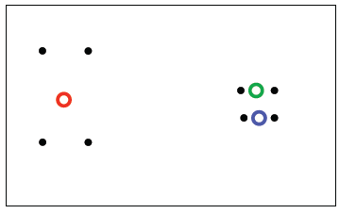
K-Means: Local Minima
The objective D is non-convex (so coordinate descent on D is not guaranteed to converge to the global minimum)
There is nothing to prevent k-means getting stuck at local minima.
We could try many random starting points
We could try non-local split-and-merge moves:
Simultaneously merge two nearby clusters
and split a big cluster into two
A bad local optimum

Slide 16
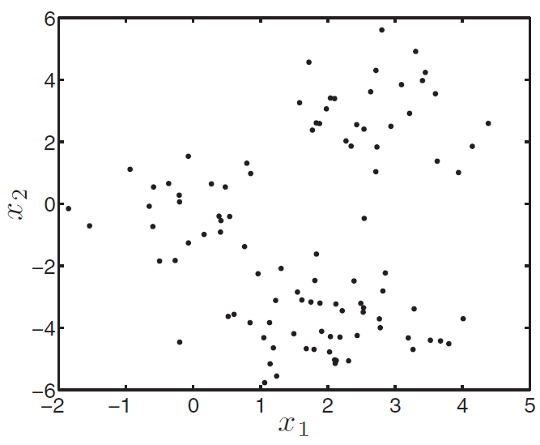
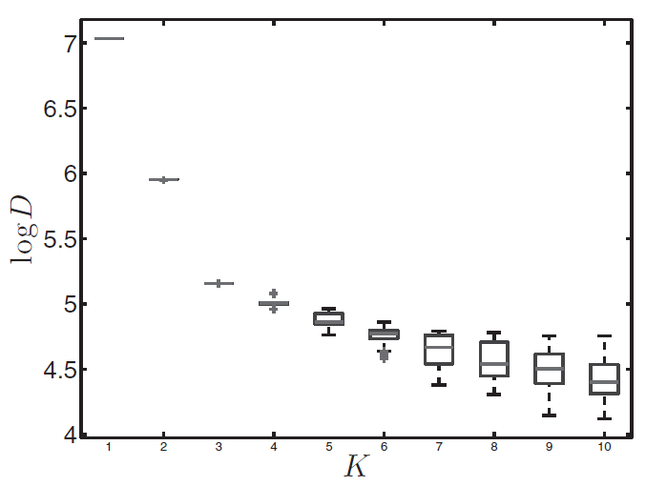
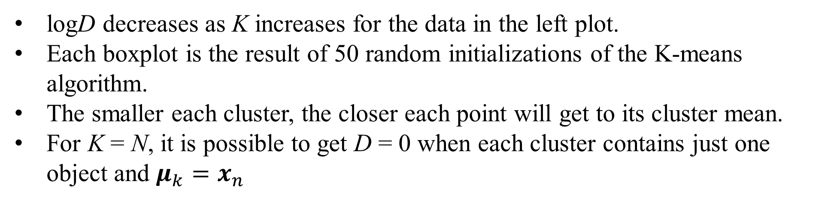
Choosing the Number of Clusters
logD decreases as K increases for the data in the left plot.
Each boxplot is the result of 50 random initializations of the K-means algorithm.
The smaller each cluster, the closer each point will get to its cluster mean.
For K = N, it is possible to get D = 0 when each cluster contains just one object and $μ_{k}=x_{n}$

Slide 17
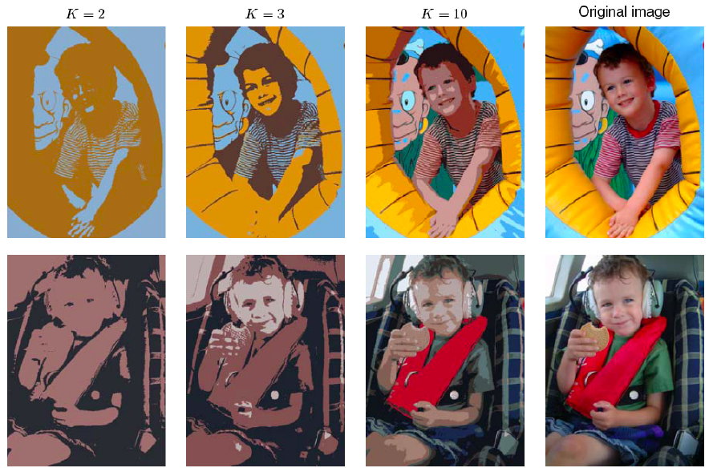
K-Means for Vector Quantization
Figure from Bishop

Slide 18
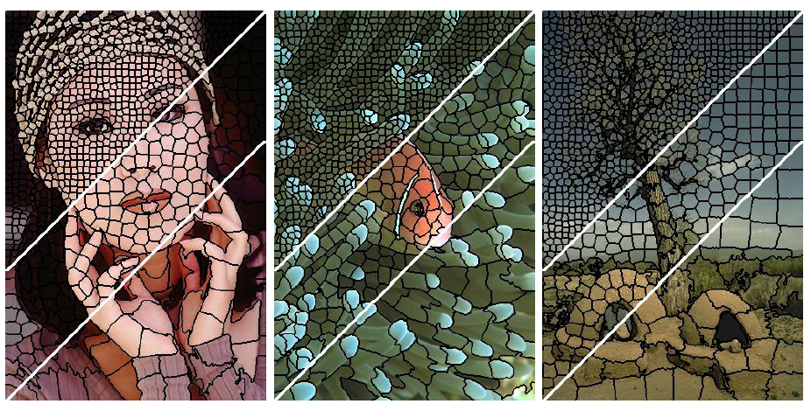
K-Means for Image Segmentation

Slide 19
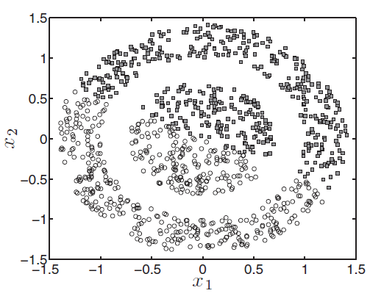
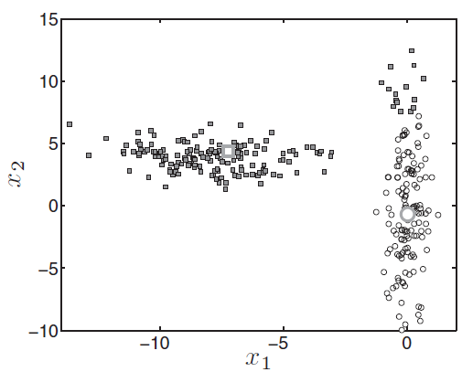
Where K-means Fails
Left: Data exist in concentric circles, K-means can never work in this setting, as the means of both circles are in the same place.
Right: Objects at the top of the right hand cluster are closer to the mean of the left hand cluster (the means are shown as large symbols).

Slide 20
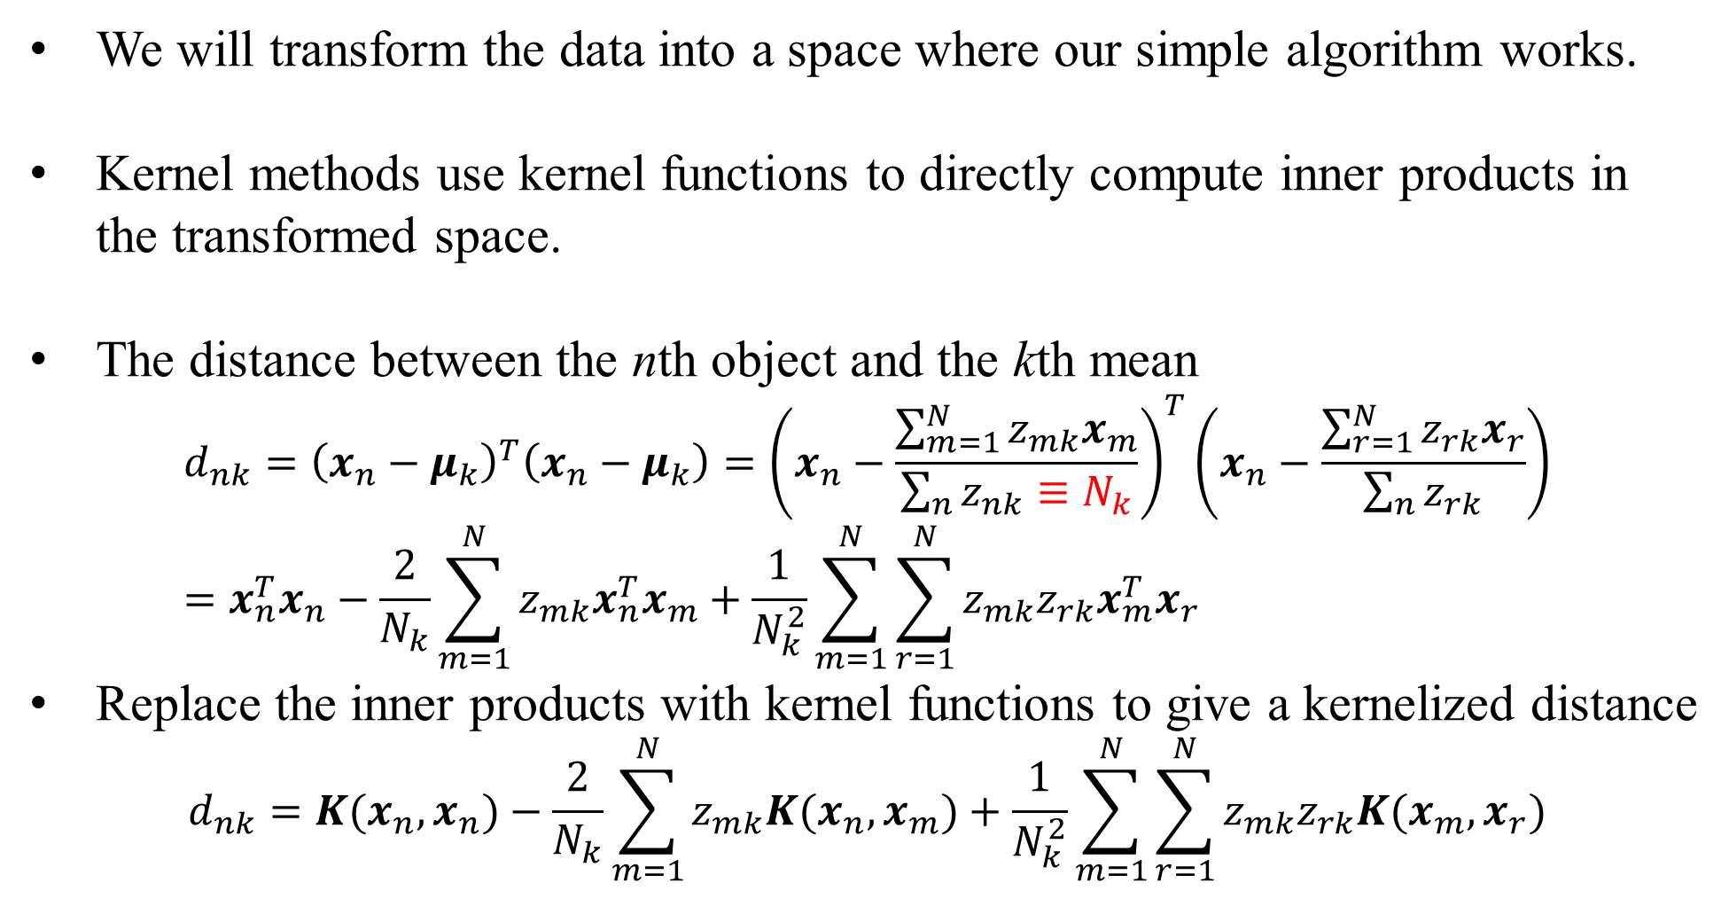
Kernelized K-means
We will transform the data into a space where our simple algorithm works.
Kernel methods use kernel functions to directly compute inner products in the transformed space.
The distance between the nth object and the kth mean
$${d_{nk}=\left(x_{n}−μ_{k}\right)}^{T}\left(x_{n}−μ_{k}\right)={\left(x_{n}−\frac{\sum_{m=1}^{N}{z_{mk}x_{m}}}{\sum_{n}{z_{nk}}≡N_{k}}\right)}^{T}\left(x_{n}−\frac{\sum_{r=1}^{N}{z_{rk}x_{r}}}{\sum_{n}{z_{rk}}}\right)=x_{n}^{T}x_{n}−\frac{2}{N_{k}}\sum_{m=1}^{N}{z_{mk}x_{n}^{T}x_{m}+\frac{1}{N_{k}^{2}}\sum_{m=1}^{N}{\sum_{r=1}^{N}{z_{mk}z_{rk}x_{m}^{T}x_{r}}}}$$
Replace the inner products with kernel functions to give a kernelized distance
$$d_{nk}=K(x_{n},x_{n})−\frac{2}{N_{k}}\sum_{m=1}^{N}{z_{mk}K(x_{n},x_{m})+\frac{1}{N_{k}^{2}}\sum_{m=1}^{N}{\sum_{r=1}^{N}{z_{mk}z_{rk}K(x_{m},x_{r})}}}$$

Slide 21
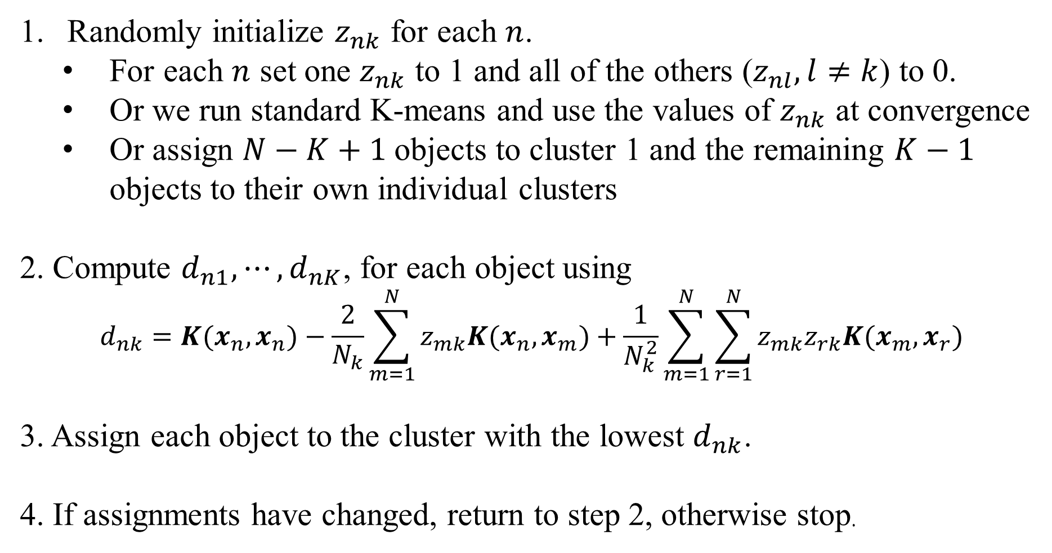
Kernelized K-Means Algorithm
Randomly initialize $z_{nk}$ for each $n$.
For each $n$ set one $z_{nk}$ to 1 and all of the others ($z_{nl}, l≠k$) to 0.
Or we run standard K-means and use the values of $z_{nk}$ at convergence
Or assign $N−K+1$objects to cluster 1 and the remaining $K−1$ objects to their own individual clusters
2. Compute $d_{n1}, ⋯,d_{nK}$, for each object using
$$d_{nk}=K(x_{n},x_{n})−\frac{2}{N_{k}}\sum_{m=1}^{N}{z_{mk}K(x_{n},x_{m})+\frac{1}{N_{k}^{2}}\sum_{m=1}^{N}{\sum_{r=1}^{N}{z_{mk}z_{rk}K(x_{m},x_{r})}}}$$
3. Assign each object to the cluster with the lowest $d_{nk}$.
4. If assignments have changed, return to step 2, otherwise stop.

Slide 22
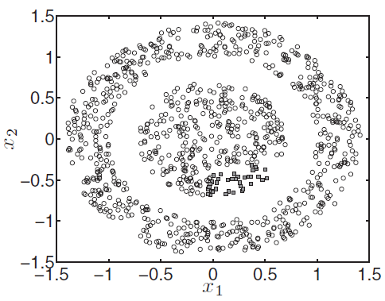
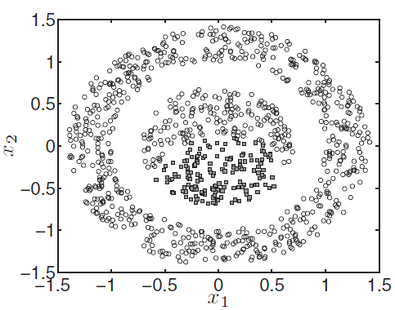
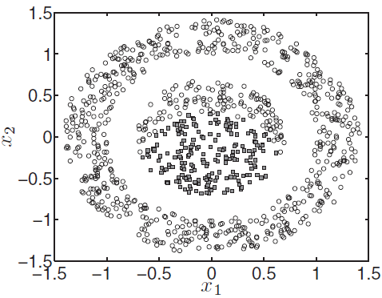
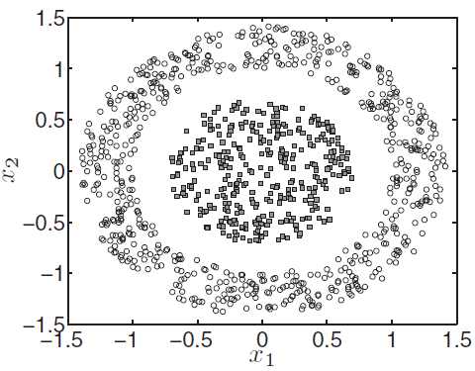
after 1 iteration
after 5 iterations
after 10 iterations
At convergence,
30 iterations

Slide 23
MATLAB script: kernelkmeans.m
%% kernelkmeans.m % From A First Course in Machine Learning, Chapter 6.
% Kernel K-means
clear all;close all;
load ../data/kmeansnonlindata/X.csv %% Load the data
figure(1);hold off
plot(X(:,1),X(:,2),'ko'); %% Plot the data
%% Compute the kernel
N = size(X,1); Ke = zeros(N); gam = 1;
for n = 1:N
for n2 = 1:N
Ke(n,n2) = exp(-gam*sum((X(n,:)-X(n2,:)).^2));
end
end
%% Run Kernel K-means
converged = 0;
% Assign all objects into one cluster except one Kernel K-means is *very* sensitive to initial conditions. Try altering % this initialization to see the effect.
K = 2; Z = repmat([1 0],N,1); s = sum(X.^2,2); pos = find(s==min(s));
Z(pos,:) = [0 1]; di = zeros(N,K);
cols = {'r','b'};

Slide 24
%% Plot the assignments
figure(2);hold off
for k = 1:K
pos = find(Z(:,k));
plot(X(pos,1),X(pos,2),'ko','markerfacecolor',cols{k}); hold on
end
while ~converged
Nk = sum(Z,1);
for k = 1:K
% Compute kernelised distance
di(:,k) = diag(Ke) - (2/(Nk(k)))*sum(repmat(Z(:,k)',N,1).*Ke,2) + ...
Nk(k)^(-2)*sum(sum((Z(:,k)*Z(:,k)').*Ke));
end
oldZ = Z; Z = (di == repmat(min(di,[],2),1,K)); Z = 1.0*Z;
if sum(sum(oldZ~=Z))==0
converged = 1;
end
figure(2);hold off %% Plot the assignments
for k = 1:K
pos = find(Z(:,k));
plot(X(pos,1),X(pos,2),'ko','markerfacecolor',cols{k});
hold on
end
end

Slide 25
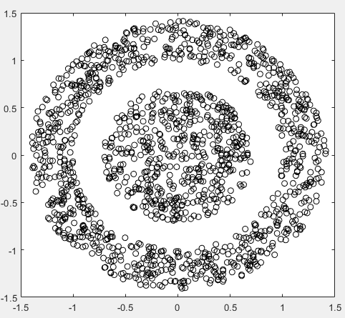
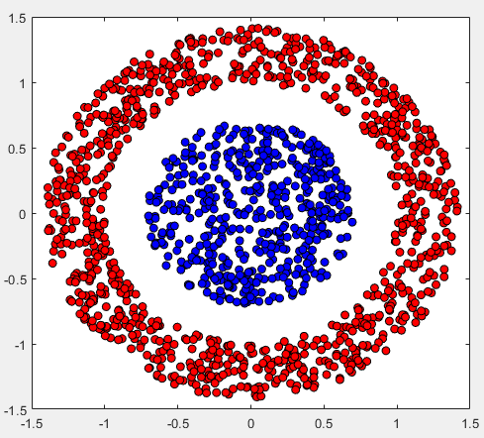
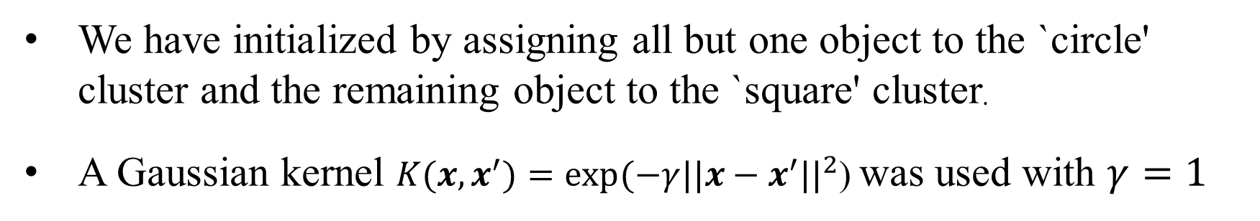
Result of MATLAB script: kernelkmeans.m
We have initialized by assigning all but one object to the `circle' cluster and the remaining object to the `square' cluster.
A Gaussian kernel ${K(x,x}^{′})=exp(−γ{{||x−x}^{′}||}^{2}$) was used with $γ=1$

Slide 26
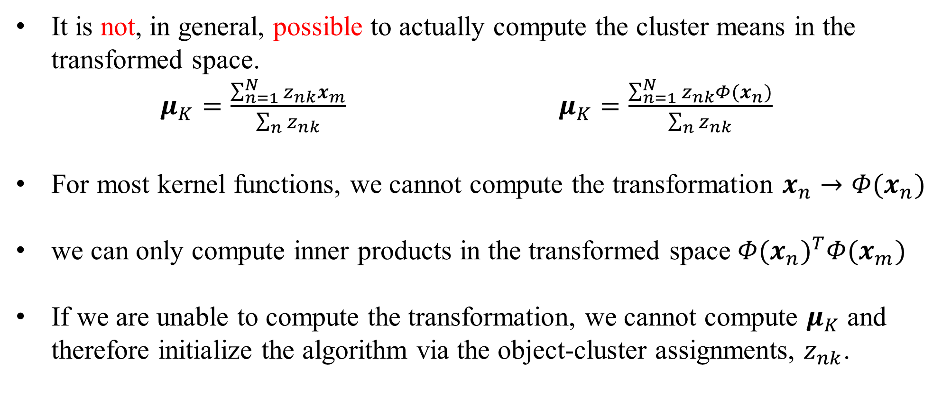
Remarks
It is not, in general, possible to actually compute the cluster means in the transformed space.
$μ_{K}=\frac{\sum_{n=1}^{N}{z_{nk}x_{m}}}{\sum_{n}{z_{nk}}}$ $μ_{K}=\frac{\sum_{n=1}^{N}{z_{nk}Φ(x_{n})}}{\sum_{n}{z_{nk}}}$
For most kernel functions, we cannot compute the transformation $x_{n}→Φ(x_{n})$
we can only compute inner products in the transformed space ${Φ(x_{n})}^{T}Φ(x_{m})$
If we are unable to compute the transformation, we cannot compute $μ_{K}$ and therefore initialize the algorithm via the object-cluster assignments, $z_{nk}$.

Slide 27
Homework # 5
Implement the Kernelized K-Means Algorithm in slide 21 using object-oriented programming.
Hint: see Homework 5_kernel_K_means_oop_to_do.jpynb
Deadline of Homework #5: 2022/10/31 3:30pm

